Slide 1
Employee Attrition Analysis Using Excel Dashboard
STUDENT NAME: LINCYA L
REGISTER NO: 312204241
DEPARTMENT: B.COM A/F
COLLEGE: ANNAI VIOLET ARTS AND SCIENCE COLLEGE

Slide 2
PROJECT TITLE
EMPLOYEE ATTRITION ANALYSIS USING EXCEL DASHBOARD

Slide 3


AGENDA
Problem Statement
Project Overview
End Users
Our Solution and Proposition
Dataset Description
Modelling Approach
Results and Discussion
Conclusion
3/21/2024 Annual Review

Slide 4

PROBLEM STATEMENT
Successful employees meet deadlines, make sales, and build the brand through positive customer interactions. Employee attrition is a major cost to an organization and predicting such attritions is the most important requirement of the Human Resources department in many organizations.

Slide 5

PROJECT OVERVIEW
The goal of the Employee Attrition Analysis project is to provide insights into employee turnover by analyzing key metrics and identifying trends that lead to attrition. Key components: Data Collection Analysis Met rice Dashboard Designer Methodology Implementation
.
.

Slide 6

WHO ARE THE END USERS?
For an image related to "Employee Attrition Analysis Using Excel Dashboard," here are some suggestions: Dashboard Overview: Visualize a sample Excel dashboard with charts and graphs showing attrition rates, employee demographics, and reasons for leaving. End Users: Represent the end users who would benefit from this analysis, such as HR managers, team leaders, and executives, possibly depicted as silhouettes or avatars interacting with the dashboard.

Slide 7

OUR SOLUTION AND ITS VALUE PROPOSITION
An Excel dashboard for employee attrition analysis is a powerful tool that allows HR departments and business leaders to track, analyze, and predict employee turnover. This dashboard provides a clear, visual representation of key attrition metrics, empowering decision-makers to implement strategies to improve employee retention.

Slide 8
Dataset Description
A typical dataset for employee attrition analysis in Excel would contain several key attributes, which are used to explore, analyze, and visualize the factors contributing to employee turnover. Below is a breakdown of commonly used data columns in such a dataset: Employee Information Employment Dataset Attrition-Related Data Work Environment & Engagement Data Compensation and Benefits

Slide 9

THE "WOW" IN OUR SOLUTION
Our Excel-based employee attrition analysis dashboard offers unique and innovative features that make it stand out from traditional HR reporting tools. These key elements create a "wow" factor that sets our solution apart and delivers exceptional value to users.
3/21/2024 Annual Review
9

Slide 10
MODELLING
To effectively analyze and predict employee attrition using an Excel dashboard, we employ a structured modeling approach that leverages statistical techniques, machine learning algorithms, and Excel’s native tools (such as PivotTables, formulas, and data visualization). Here’s a breakdown of the modeling process used in the employee attrition analysis:
10

Slide 11
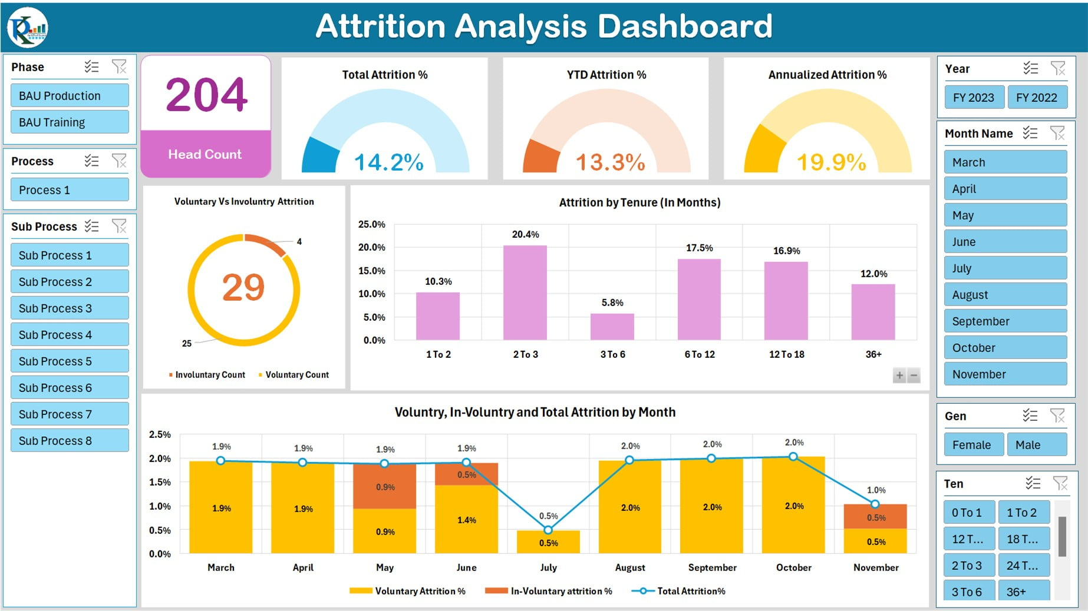
RESULTS
11

Slide 12
conclusion
An Excel-based Employee Attrition Analysis Dashboard offers an accessible, powerful, and customizable solution for understanding and managing employee turnover. By leveraging descriptive analytics, predictive modeling, and intuitive data visualization, the dashboard provides HR professionals and business leaders with actionable insights to proactively address attrition challenges.

